Slide 1
Shortest-Path Problem
EECS 233

Slide 2
The Shortest-Path Problem
What is the “shortest” path from one vertex to another – i.e., the one with the minimal total cost
  Travel: lowest mileage or fastest trip
  Internet: forwarding traffic along the “best” router paths.
Given a source, find the shortest path to a destination
Given a source, find the shortest path to many (all) destinations

Slide 3
First, A Special Case
A solution for an unweighted graph:

Slide 4
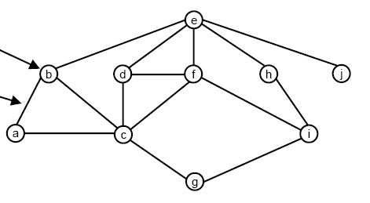
First, A Special Case
A solution for an unweighted graph:
  Start a breadth-first traversal from the origin, x
  Stop the traversal when you reach the target, y
  The path from x to y in the resulting (possibly partial) spanning tree is a shortest path
A breadth-first traversal works for an unweighted graph because
  the shortest path is simply one with the fewest edges
  a breadth-first traversal visits nodes in order according to the number of edges they are from the origin.

Slide 5
Method for the Special Case
(Pseudo-code)
  shortestPath_bfTrav(source, desti)
    mark source as encountered
    source.parent = null
    source.cost = 0;
    create a new queue q
    q.insert(source);
    while (!q.isEmpty())
      v = q.remove()
      if (v==desti) break;
      for each vertex w in v's neighbors
        if w is not encountered
        mark w as encountered
        w.parent = v;
        w.cost = v.cost + 1;
        q.insert(w);

Slide 6
Shortest paths for Weighted Graphs:
Dijkstra’s Algorithm
Finds the shortest paths from vertex v to all other vertices that can be reached from v.
  The single-source-all-destinations problem
Assumptions:
  Graph is connected.
  Edge cost is non-negative
    More hops = higher cost
Basic idea:
  maintain estimates of the shortest paths from v to every vertex (along with their associated costs)
  gradually refine these estimates as we traverse the graph

Slide 7
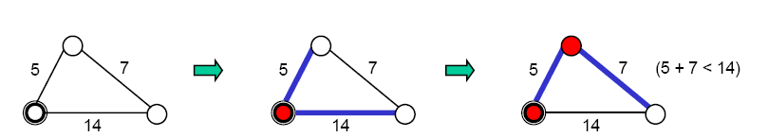
Dijkstra’s Algorithm
We say that a vertex w is finalized if we are certain we have found the shortest path from v to w.
We repeatedly do the following:
  find the not-yet-finalized vertex w with the lowest cost estimate
  mark w as finalized (shown as a filled circle below)
  examine each not-yet-finalized neighbor x of w to see if there is a shorter path to x that passes through w; if there is, update the shortest-path estimate for x
w
w
x
x

Slide 8
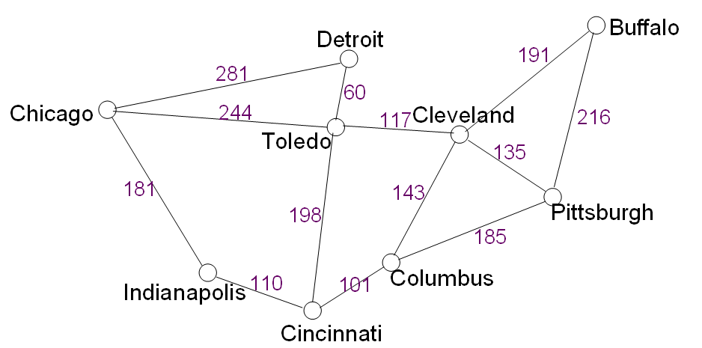
Intuition Behind Dijkstra’s
For an unweighted graph, the breadth-first traversal method expands the search circle by one hop every round
For a weighted graph, Dijkstra’s method expands the search circle by one lowest-cost node every round

Slide 9
Example: Shortest Path from Buffalo To Toledo
Distance to Buffalo is 0, so it is finalized
Initially set distance estimates:
  To all neighbors - edge weights
  To other cities - unknown, using infinity
Which will be finalized?
(∞)
Buffalo
Detroit
191
281
60
(191)
Chicago
244
117
Cleveland
216
(∞)
Toledo
(∞)
135
(308)
181
143
198
Pittsburgh
185
(216)
Indianapolis
110
101
Columbus
(∞)
(∞)
(334)
Cincinnati
(∞)

Slide 10
Why Can We Finalize A Vertex?
Let w be the not-yet-finalized vertex with the smallest cost estimate. Why can we finalize w, before seeing the rest of the graph?
We know that w’s current estimate is the cost of the shortest path to w:
  The shortest path to w must pass through only finalized vertices.
    Any path to w passing through any not-yet-finalized vertex t would be longer than the path that produced w’s cost estimate. Indeed, assume the contrary:
    Let t be the first not-finalized node “across the border”. Then path to t would be shorter (contradicting the fact that w has the smallest estimate).
  Then the path corresponding to the current estimate is the shortest path:
    If there was another, shorter path we would have learned its estimate when we finalized w’s predecessor on that path

Slide 11
Dijsktra’s Algorithm
Notation:
c(x,y): link cost from node x to y;
∞ if not direct neighbors
D(v): current path cost estimate from source to dest. v
p(v): predecessor node along path from source to v
N: set of nodes whose least cost path definitively known
u: starting node
1 Initialization:
2 N = {u}
3 for all nodes v
if v adjacent to u then
D(v) = c(u,v)
6 p(v) = u
else D(v) = ∞
8 Loop
9 find w not in N with smallest D(w)
10 add w to N
11 update D(v) for all v adjacent to w and not in N' :
D(v) = min( D(v), D(w) + c(w,v) )
Update p(v)
13 /* new cost to v is either old cost to v or known
14 shortest path cost to w plus cost from w to v */
15 until all nodes are in N
5
v
3
w
2
5
u
2
1
z
3
1
2
x
y
1

Slide 12
Dijkstra’s algorithm: example
Step
0
1
2
3
4
5
N
u
ux
uxy
uxyv
uxyvw
uxyvwz
D(v),p(v)
2,u
2,u
2,u
D(w),p(w)
5,u
4,x
3,y
3,y
D(x),p(x)
1,u
D(y),p(y)
∞
2,x
D(z),p(z)
∞
∞
4,y
4,y
4,y
5
v
w
v
3
w
u
2
5
z
u
2
1
z
3
x
1
2
y
x
y
1

Slide 13
Implementation Issues
Data structure: adjacency lists
How to find the not-yet-finalized vertex with the minimal cost? What data structure can be used to make it more efficient?
1
191
2
216
0
Buffalo
null
1
0
191
2
135
3
143
Cleveland
2
Pittsburgh
……
3
Columbus
……

Slide 14
Dijsktra’s Algorithm: Complexity
1 Initialization:
2 N = {u}
3 for all nodes v
4 if v adjacent to u
5 then D(v) = c(u,v)
6 else D(v) = ∞
7
8 Loop
9 find w not in N with smallest D(w)
10 add w to N
11 update D(v) for all v adjacent to w and not in N :
12 D(v) = min( D(v), D(w) + c(w,v) )
13 /* new cost to v is either old cost to v or known
14 shortest path cost to w plus cost from w to v */
15 until all nodes in N
// V iterations
// Check of the total of up to E edges
// O(V) to build the heap
// V iterations
// logV to reorg
the heap
// A step per every link (E total); logV
per step to reorganize the heap
Overall complexity is O(V + E +VlogV + ElogV) = O(ElogV)

Slide 15
All-Pairs Shortest-Path Problem
Dijkstra’s algorithm solves the problem of single-source all-destination shortest paths
It can be used to solve the all-source all-destination shortest path problem too
  Run Dijkstra’s V times, once for each vertex
  Running time: O(VE logV)

Slide 16
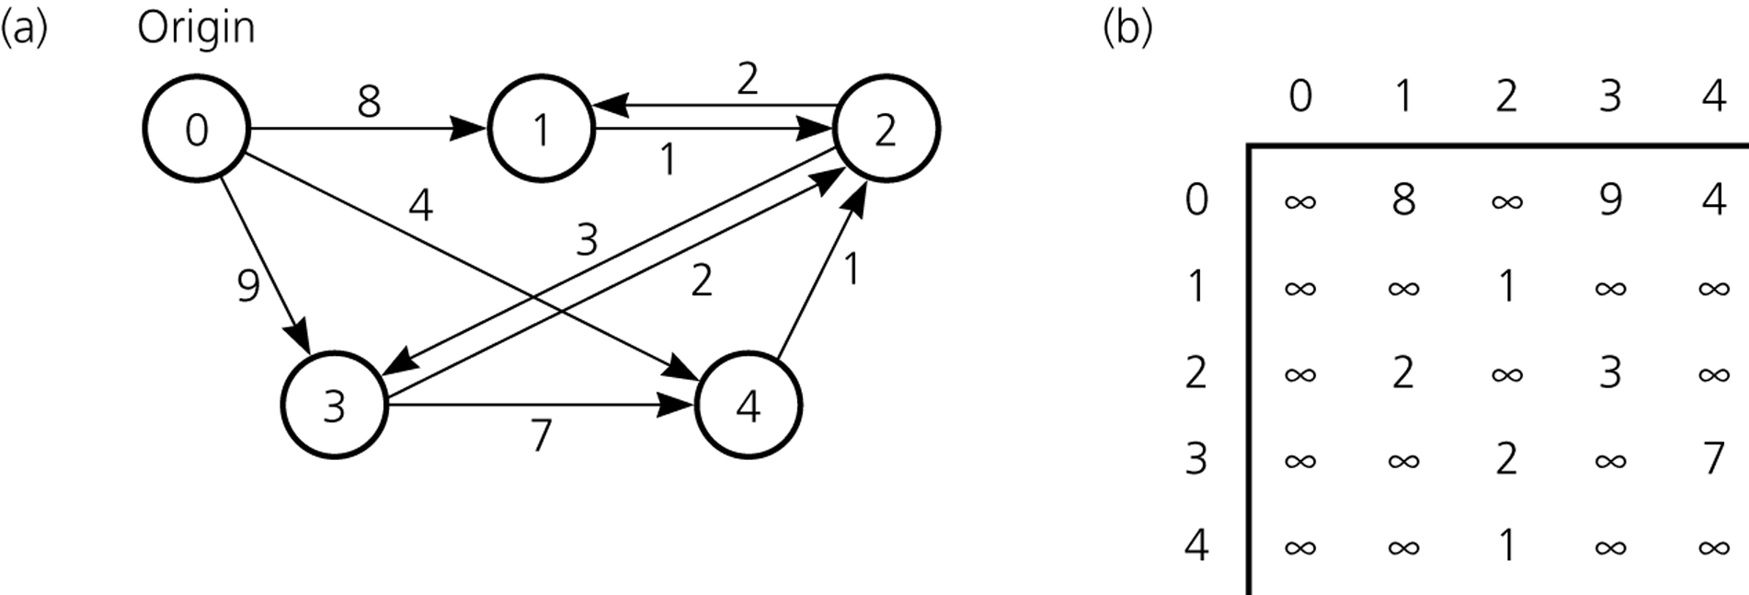
Shortest Paths
A Weighted Directed Graph Its Adjacency Matrix

Slide 17
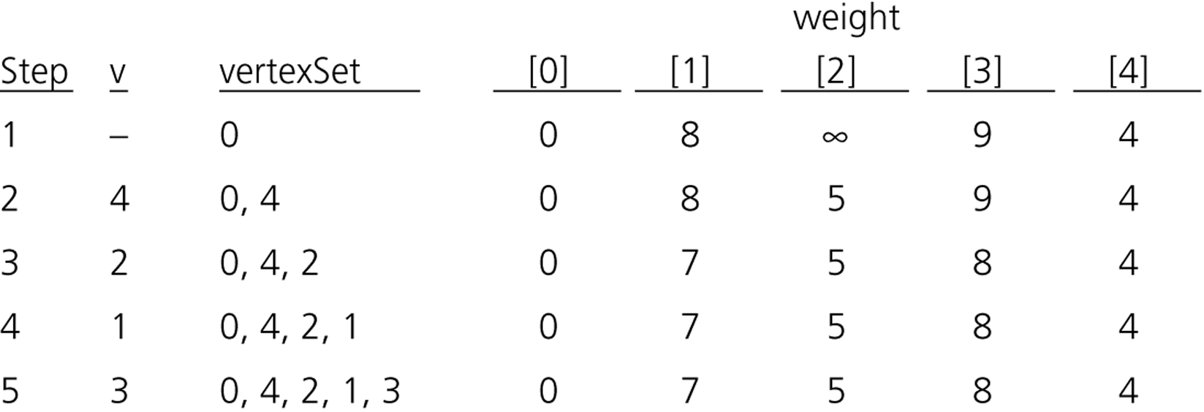
Dijkstra’s Shortest-Path Algorithm – Trace

Slide 18
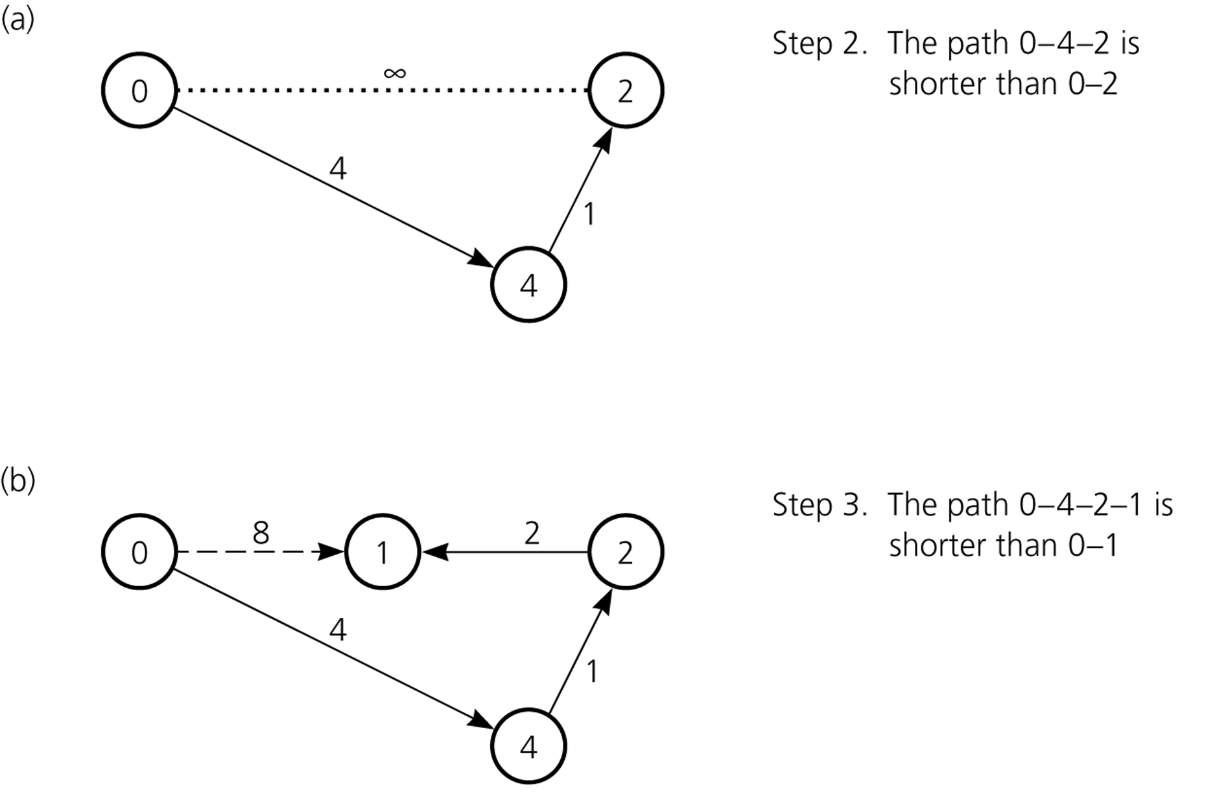
Dijkstra’s Shortest-Path Algorithm – Trace (cont.)

Slide 19
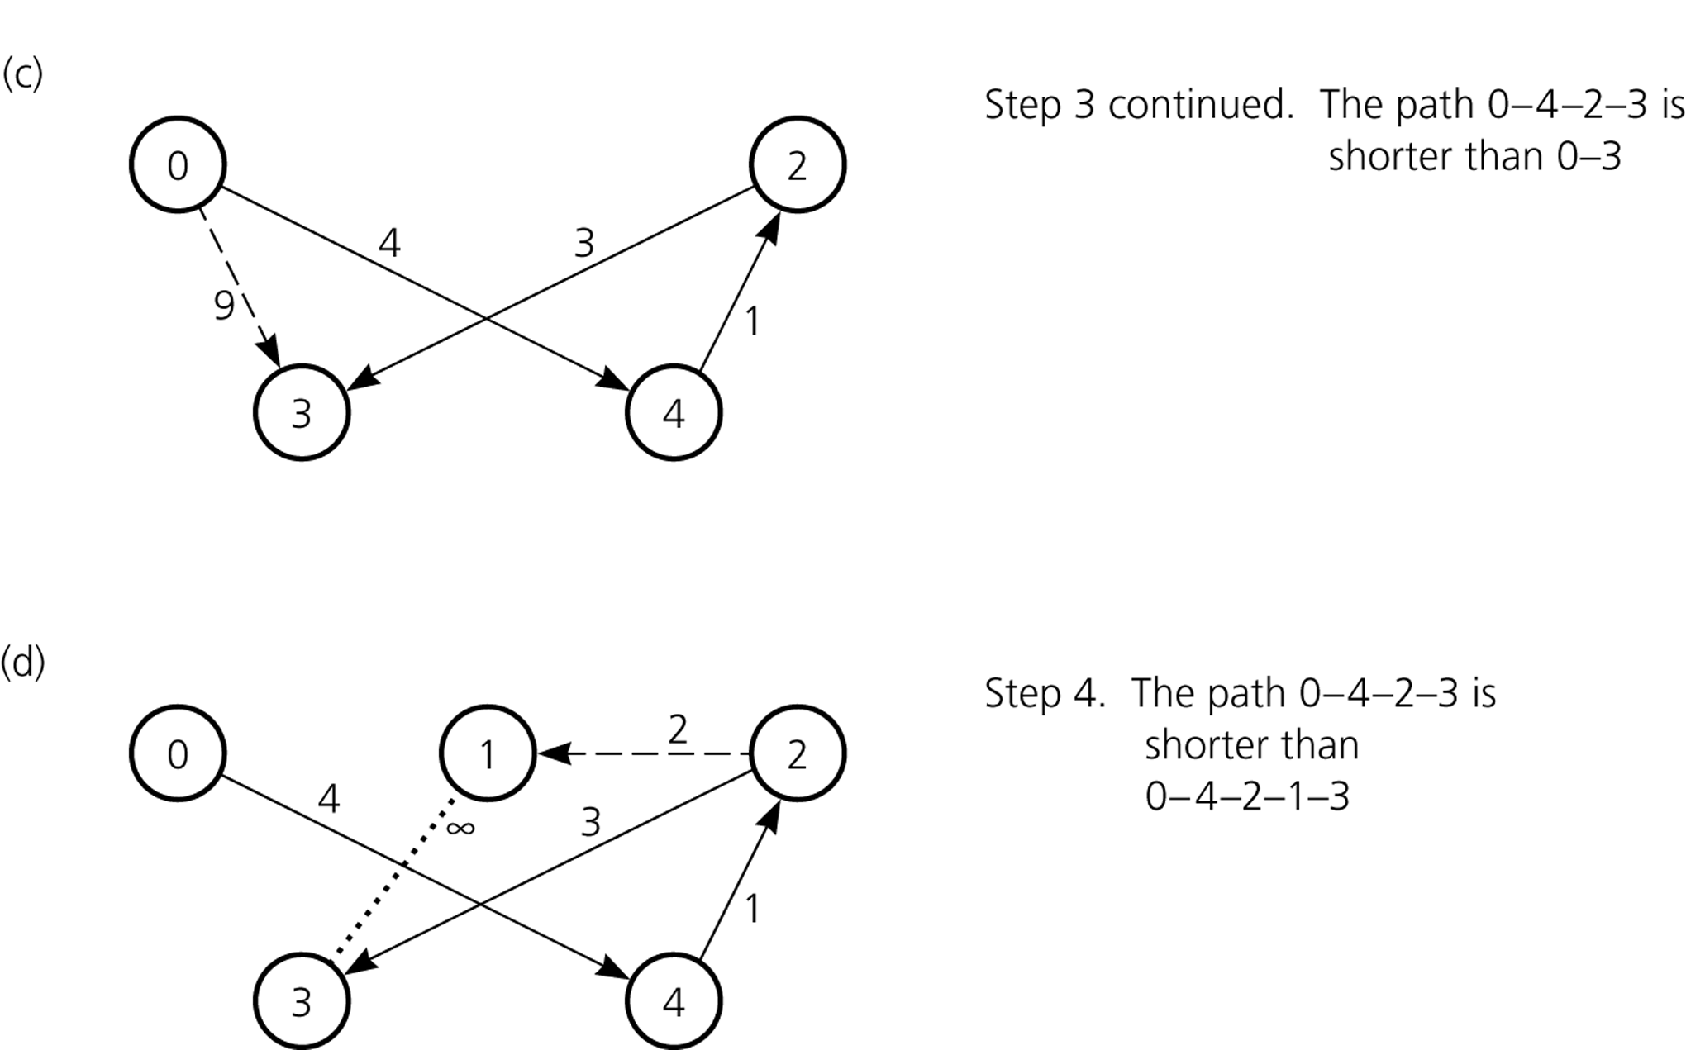
Dijkstra’s Shortest-Path Algorithm – Trace (cont.)

